Slide 1
A Physics-Guided Deep Learning Predictive Model for Robust
Production Forecasting and Diagnostics in Unconventional Wells
DSCI560
Instructor：Young Cho, Ph.D.
Yifan Yang
8386626867

Slide 2
INTRODUCTION
Highlights from what I read：
Flow simulation models of dense formations with complex fracture networks still require long-term fundamental research and more understanding of the physical processes occurring in these complex systems to fully represent flow and transport processes.
The proposed prediction model combines the advantages of data-driven and physics-based methods. Purely data-driven models have limited generalization capabilities beyond the range of data used in their training, but can capture complex hidden patterns. Purely physics-based models may be based on imperfect physical models but can provide causal predictions for any range of input parameters.
Deep learning predictive models learn the difference between simulated and observed production data and use this to enhance the accuracy of simulation-based predictions.
SECTION TITLE | 2
SECTION TITLE | 2

Slide 3
Methods
The workflow of their proposed hybrid multi-task prediction model is introduced. They used a deep convolutional neural network architecture that took well attributes (completion, formation, and fluid properties) as input to predict simulation error, cumulative oil production, and likelihood of well success.
Through the concept of multi-task learning, they designed a statistical prediction model to create shared feature representations for multiple tasks, thereby improving the model's generalization ability and reducing the expensive cost of data collection and curation.
approach accounts for prediction errors by correcting production curves obtained from a physical simulator, thereby providing a reliable diagnostic tool for understanding well performance under different well properties.
approach was tested on field data from the Bakken Shale Play in North Dakota, using simulated production response data obtained from a physics simulator, and a deep learning architecture jointly trained with field and simulated data.

Slide 4
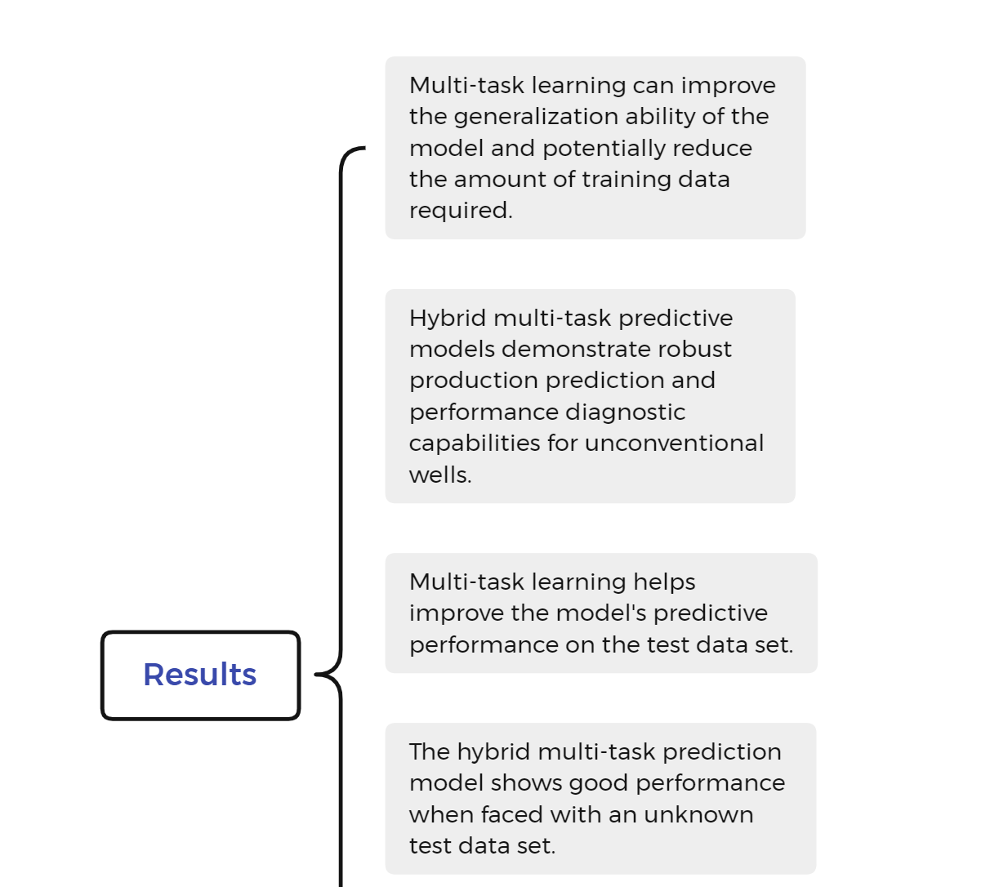
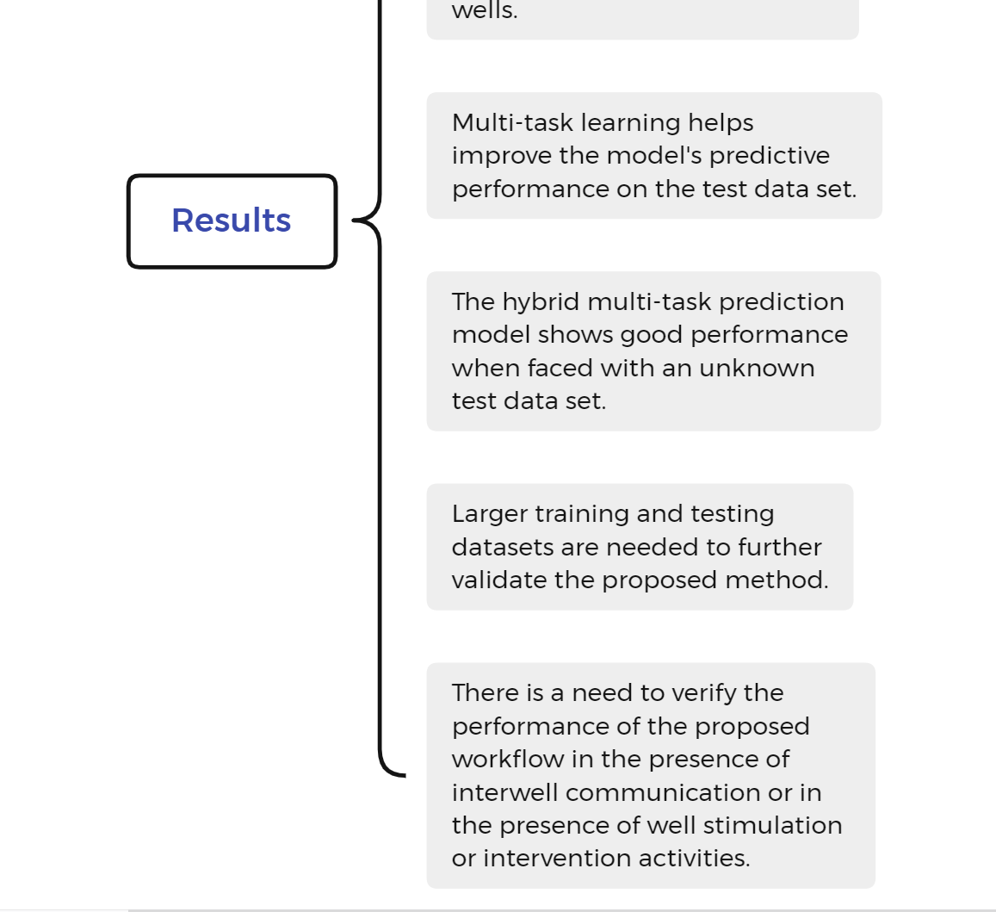
RESULTS

Slide 5
Discussions and Conclusions
Highlights from what I read：
It is emphasized that deep learning prediction models combine the advantages of data-driven methods and physics-based methods, and are able to learn the differences between simulated and observed production data, thereby improving the accuracy of simulated predictions. Through the concept of multi-task learning, a statistical prediction model is designed to create shared feature representations for multiple tasks, improving the model's generalization ability and reducing the cost of data collection and sorting.
Q1: How does multi-task learning help improve the model's predictive performance on the test dataset?
A1: Multi-task learning improves the model's generalization ability and reduces the cost of data collection and sorting by creating shared feature representations for multiple tasks, thereby helping to improve the model's predictive performance on test data sets.

